Slide 1
Estimating the Economic Value of Zoning Reform
Santosh Anagol Fernando Ferreira Jonah Rexer
Wharton Wharton World Bank
World Bank Land Conference
May 14 2024

Slide 2
Motivation
World urban population grew from 33% in 1960 to 56% in 2019, and predicted to reach 68% in 2050
Zoning and building regulations a major constraint to private sector supply of new housing (NIMBY) (Gyourko, Hartley, and Krimmel, 2021)
Quantity and price of housing (Glaeser, Gyourko, and Saks, 2005, Gyourko and Molloy, 2015, Glaeser and Gyourko, 2018)
Segregation and economic convergence (Trounstine, 2018, Ganong and Shoag, 2017)
Aggregate economic output (Hsieh and Moretti, 2019)
But difficult to study:
Zoning policy endogenous
Lack of micro data
Difficult to measure general equilibrium effects in reduced from designs
Notes:
Zoning difficult to study because:
Zoning policy is endogenous
High prices might cause more restrictive zoning (reverse causality)
Limited empirical evidence on how developers and households respond to reforms
Lack of micro data
Most evidence we have is from cross-city studies.
Difficult to measure all supply-demand consequences of zoning reform, general eqm effects
Benefits: new buildings, lower prices, access to jobs
Costs: congestion, demographic changes
Wealth transfers from current to future owners
Developer profits
Agglomeration effects

Slide 3
This paper
Study housing market impact of a major block-by-block zoning reform in the city of Sao Paulo, Brazil
Observe detailed changes in density restrictions for each block
Focus on residential construction
Use boundary discontinuity design to estimate supply responses
Deals with endogeneity of prices and neighborhood characteristics
Estimate equilibrium model of housing supply and demand
Quantify trade-offs between costs/benefits of densification
Counterfactual simulation of zoning reform to estimate welfare and long-term effects on house prices, built environment, and household sorting

Slide 4
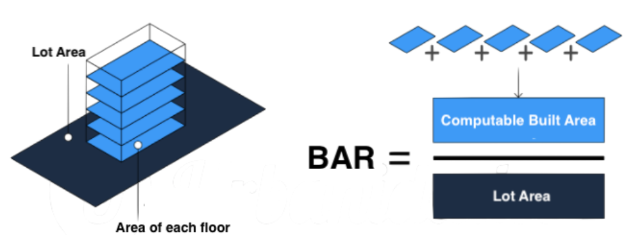
2016 zoning reform in Sao Paulo
Unified built area ratio (BAR) throughout city
Previous 2004 law had BAR chosen by sub-regions
City classified three broad areas with distinct goals:
Transformation: Allow more density mostly around transportation corridors
Qualification: Small adjustments for established neighborhoods
Preservation: Less density and more preservation in the city outskirts
Max BAR increase in >50% of blocks
45% of the 45K city blocks had a Max BAR increase of 1 or more
Average increase from 1.54 to 2.09 (36%)
Map of 2016 reform
Notes:
Computable ~ living space (not including elevators, hallways, etc.)
Developers can build more floors and units for a given parcel when BAR is higher.

Slide 5
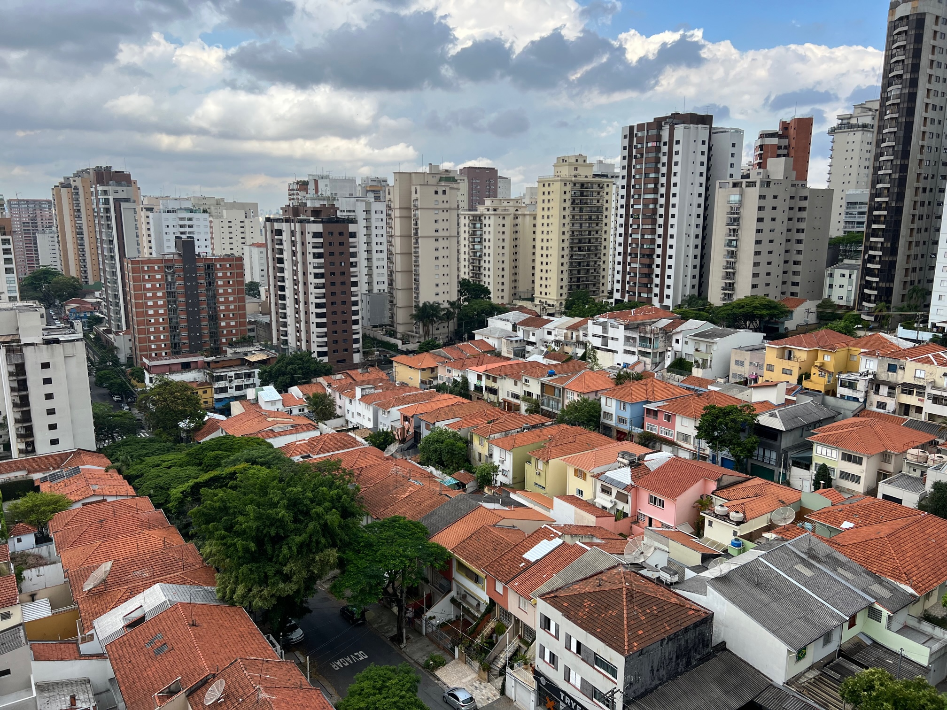

Slide 6
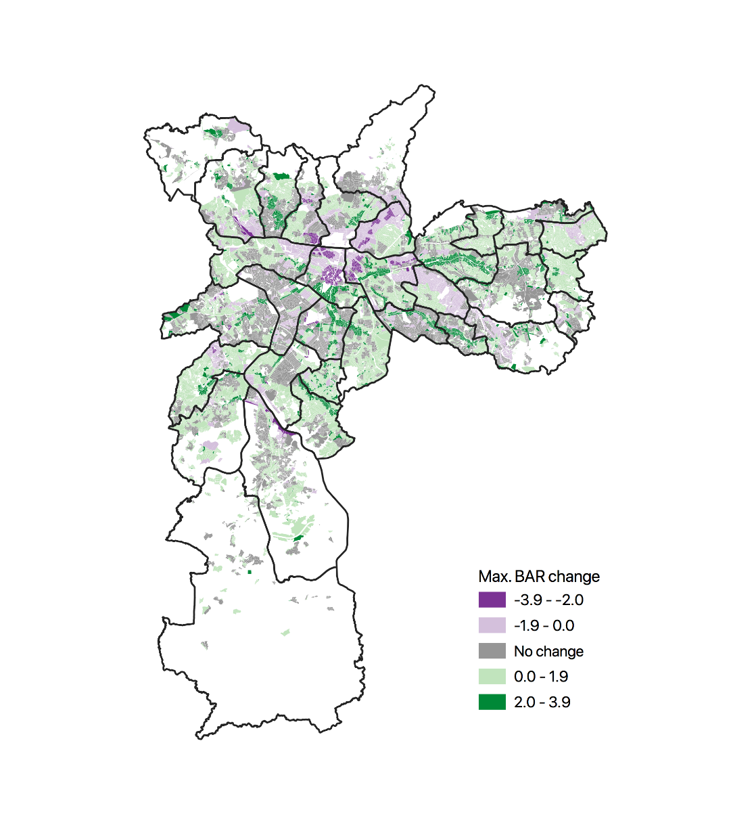
Research design
Boundary discontinuity design
Treatment if Max BAR increased in 2016 reform
Control if Max BAR stays the same or decreased
Running variable: distance to nearest block of opposite treatment status
Data
Outcome: universe of building permits
Housing characteristics: 3M municipal property tax records
Treatment: block-level zoning maps for 2004 and 2016.
Permitting trends
Notes:
Why max BAR instead of BAR or shadow ratios? Mostly new apartment buildings, densification is critical. Little action on shadow ratio and BAR, but we will control for that in empirical specification.

Slide 7
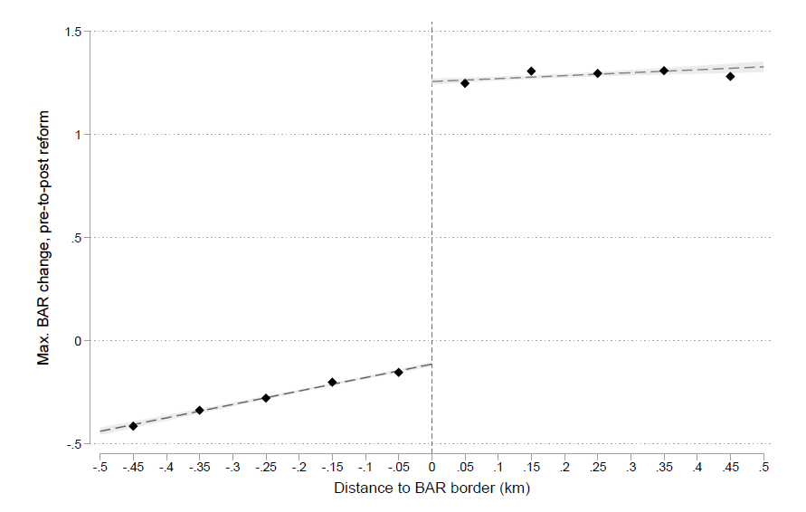
Max BAR change at boundary
Block counts; first stage estimates; balance tests
Notes:
Average BAR in city prior to reform is 1.5. At D>0 was 1.3, then increased to 2.6, while D<0 remained around 1.7.
This is very low. For context, BAR can be as large as 10 in places like Hong Kong.

Slide 8
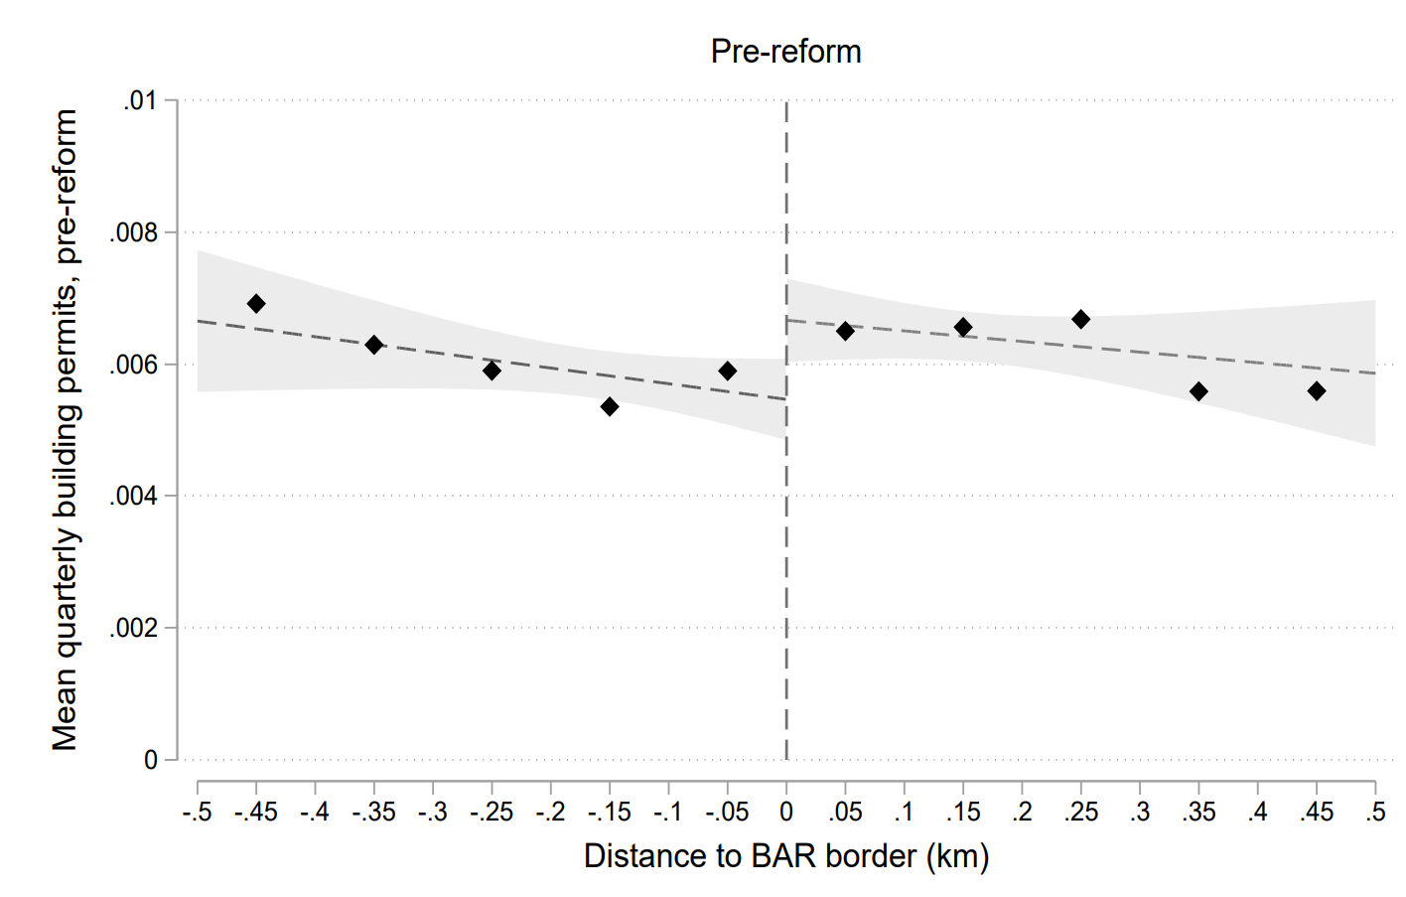
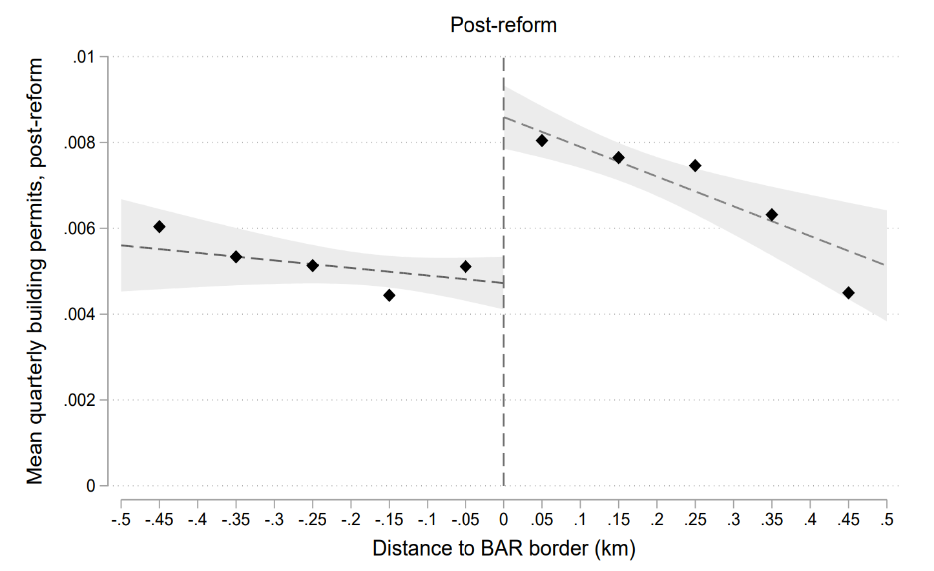
Reform impact on multifamily permits
Effect size: ~0.003 more filed permits per block per quarter at cut-off, which is a 67% increase in permits for avg 1.35 increase in Max BAR
Estimates; bandwidth tests; single family; approvals; dynamics; spillovers

Slide 9
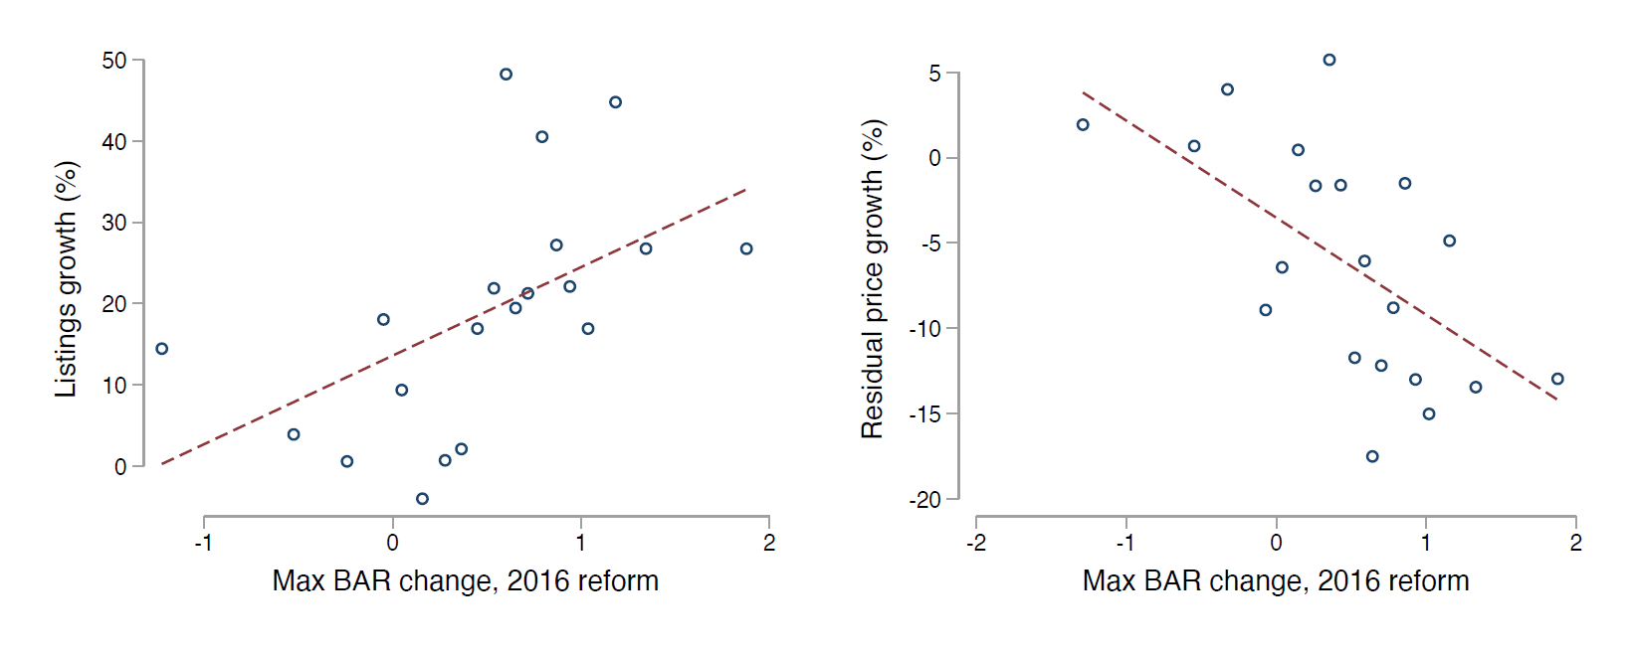
Listings and prices by neighborhood
Aggregating data by 329 commuting zones - neighborhoods with ~10K people - then plotting binned averages
Find that 1-unit Max BAR increase is correlated with a 10.9% increase in listings and 5.7% reduction in prices; listings RD

Slide 10
Equilibrium model of the housing market
Estimate welfare consequences of 2016 zoning reform
Long term impacts on built environment, prices, and household sorting
Simulate more aggressive zoning reform
Demand: Neighborhood choice in prices/amenities (Bayer et al. 2007)
Model: Random coefficients multinomial logit (Berry et al. 1995)
Two stage estimation (microBLP): MLE + 2SLS
IVs: “Ring” of neighborhood features for price
Supply: Developers apply for permits as a function of prices and zoning
Model: Poisson regression for count outcome
Estimation: GMM
IVs: Bartik labor demand shock for price, reform RD for zoning
Demand model; supply model

Slide 11
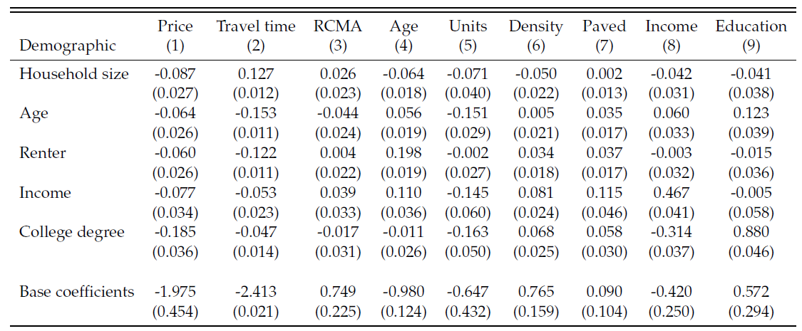
Demand estimates
Notes:
RCMA: Residential commuter market access
Base coefficients (how variables affect average utility in a neighborhood): Price is negative, RCMA positive, Age is negative, number of units in building is negative but neigh density is positive, paved is positive, income is negative and education is positive.
5 individual characteristics: household size, age, renter, income, and college degree.
Interaction income and income is highly positive, which means poor people not as eager to live closer to rich people. Majority of people poor in SP.

Slide 12
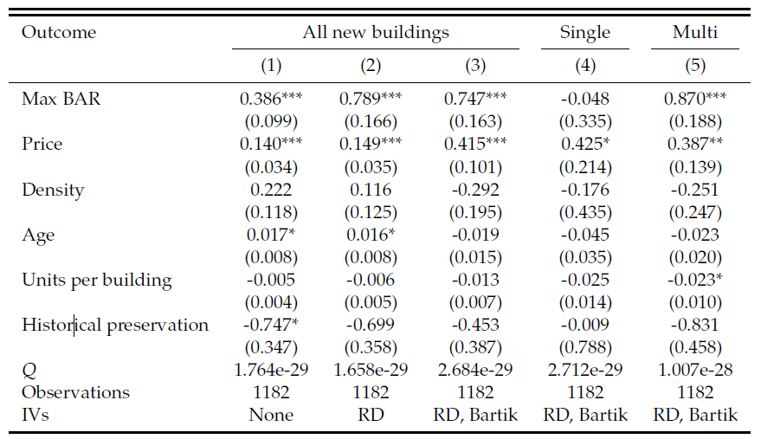
Supply estimates
Bartik IV plots
Notes:
Max BAR increases by 1, increases new permits by 5
Price: Increase in $1,000 reais per square meter (~20% increase in prices), increase permits by 2.34)

Slide 13
Equilibrium and simulation
Equilibrium condition: supply = demand in each neighborhood:
Simulation:
Shock the model with a zoning map $M$
Search for price vector $p$ that solves this system of J nonlinear equations given $M$
Calculate new neighborhood features at $p$:
Age, number of units, density, travel time, and demographics
Counterfactuals: 10-year horizon
2004 zoning, 2016 zoning, “Double BAR” scenario
Notes:
2004 zoning: Baseline, assumes continuation of pre-2016 reform zoning parameters
2016 zoning: Key counterfactual based on 2016 zoning reform parameters
Double BAR: More aggressive pro-densification reform
Doubling BAR for areas with positive BAR change in 2016, and also making negative changes equal to zero
Assume population will grow to meet new housing stock
Realistic assumption for Sao Paulo, but also run model with fixed population and allowing for housing vacancies

Slide 14
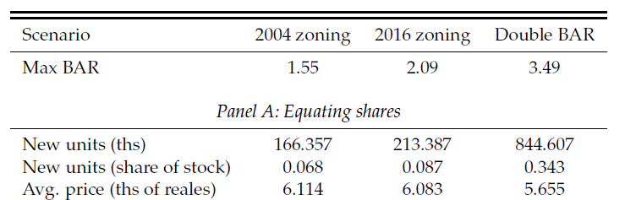
Simulation: Prices and quantities
Reform has the following outcomes after 10-year period:
47K more new units (1.9% of stock)
0.5% reduction in average prices
Results much larger with double BAR, but assumptions less credible
Model validation prices; demographics; map
Notes:
Double BAR: Much larger effects in new construction: 40% increase in 10 years. Prices now reduced by 10% (in shares)

Slide 15
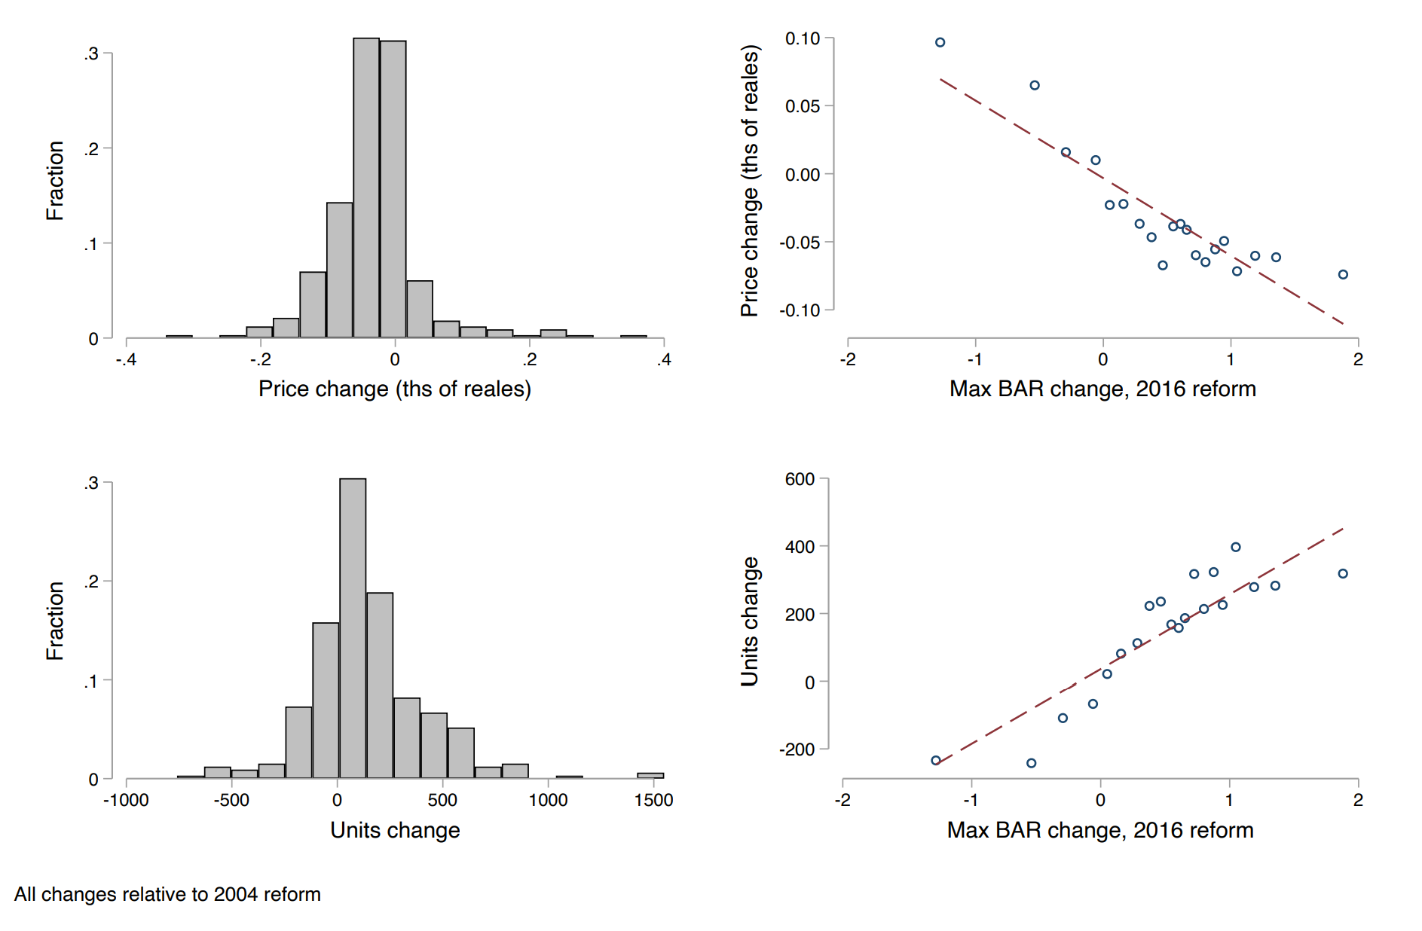
Higher supply, lower prices
Notes:
Explain heterogeneity key results
neighborhoods with highest Max BAR change had increases in construction by 14% and reductions in prices by 5.6%.
These figures replicate what we see in the preliminary data on listings and prices.

Slide 16
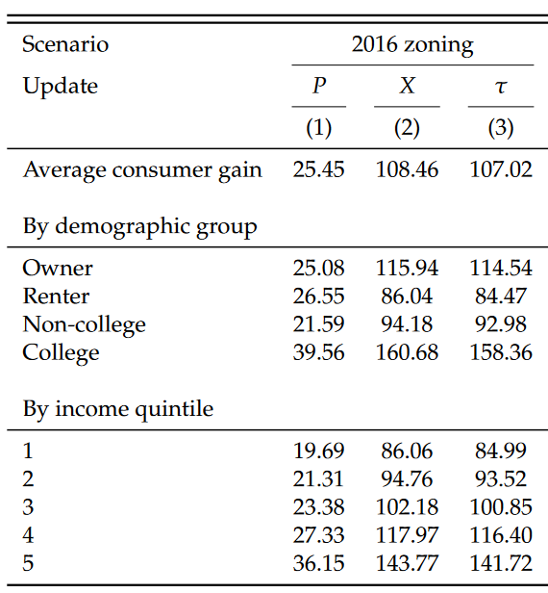
Consumer surplus
Average household gain is small: R$107
Gains from changes in built environment 4.3x larger than gains from price reductions – changes in commuting not very important
Largest gains to highest education and income groups
Notes:
1) College and high income benefit the most – new supply allows them to choose better neighborhoods (more people moving from suburbs to city, and they are higher income and higher education). As a result, avg demographics in the city don’t change much, but increased inequality wrt/suburbs.
2) Much larger impact once allow for new built environment to affect utility. Key is new construction: households gain from living in new buildings and in denser neighborhoods, because they prefer these on average.
3) Congestion costs don’t seem to matter much, only reduce welfare gains very slightly.

Slide 17
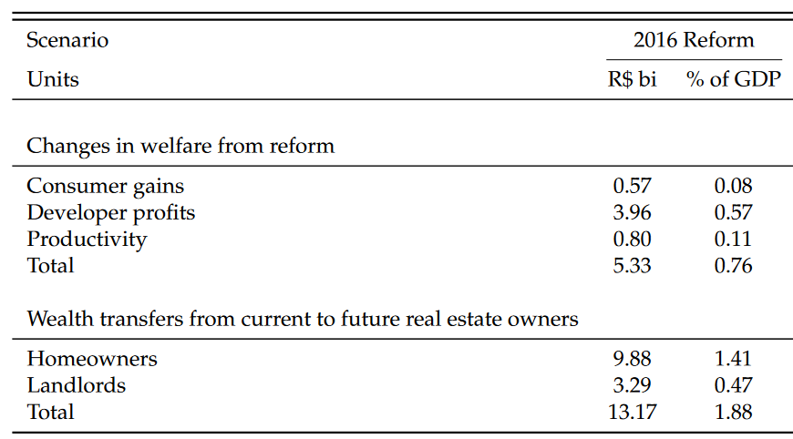
Welfare and transfers
Total welfare increased by 0.76% of GDP
Most gains from developer profits, not consumer gains
Price reductions result in large wealth transfers
Such transfers are 2.5 larger than welfare gains
Notes:
2016 Reform: somewhat similar to what was proposed in California- don’t expect gigantic changes, just modest gains
Glaeser and Gyourko (2018) argues that increasing housing supply in the whole country in a way that equalizes wages across locations would increase GDP by 1-2%
For example, NYC would have to increase supply by 33%
Our Double BAR counterfactual increases supply by 21.8%; potential change in productivity could increase Sao Paulo GDP by 1.31%

Slide 18
Conclusion
We analyze a major zoning reform, and develop a model to estimate welfare consequences
Zoning reform achieved intended goals, but gains were modest
Short term increase in permit fillings and approvals, especially for multifamily buildings; subsequent increase in housing availability and price reductions
Welfare increases due to price reductions and new built environment
Larger gains for high income and college degree households
Large housing wealth transfers from current owners may prevent future reforms
Framework allows for evaluation of alternative zoning policies
Doubling densification would produce much larger welfare gains

Slide 19
APPENDIX

Slide 20
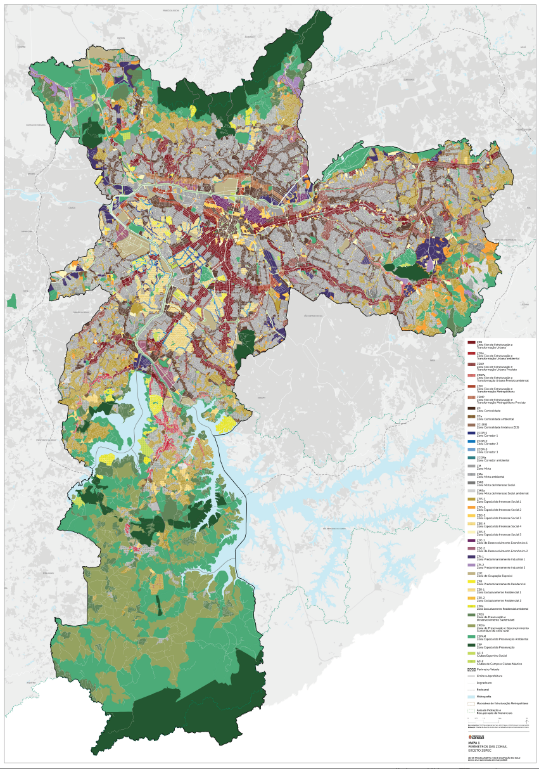

Slide 21
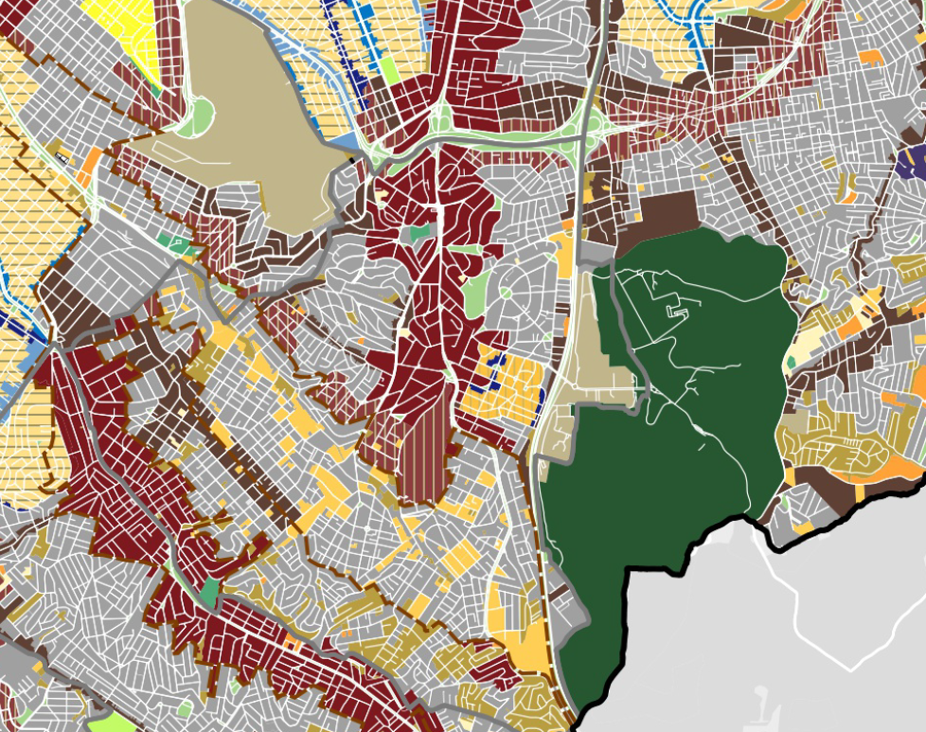
Neighborhood zoom: Jabaquara
Notes:
Transformation: Wine/Brown
Environmental: Green
Gray: low density mixed zone (commercial and residential)
Yellow: Only residential
Orange: Special social interest
Light green: clubs and sports

Slide 22
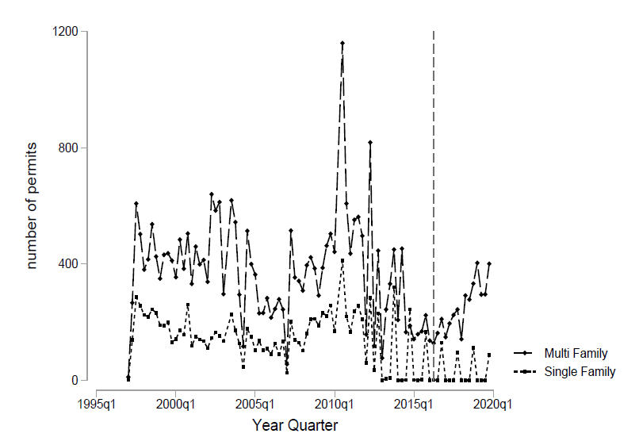
Multi and single-family permits

Slide 23
Block counts by running variable

Slide 24
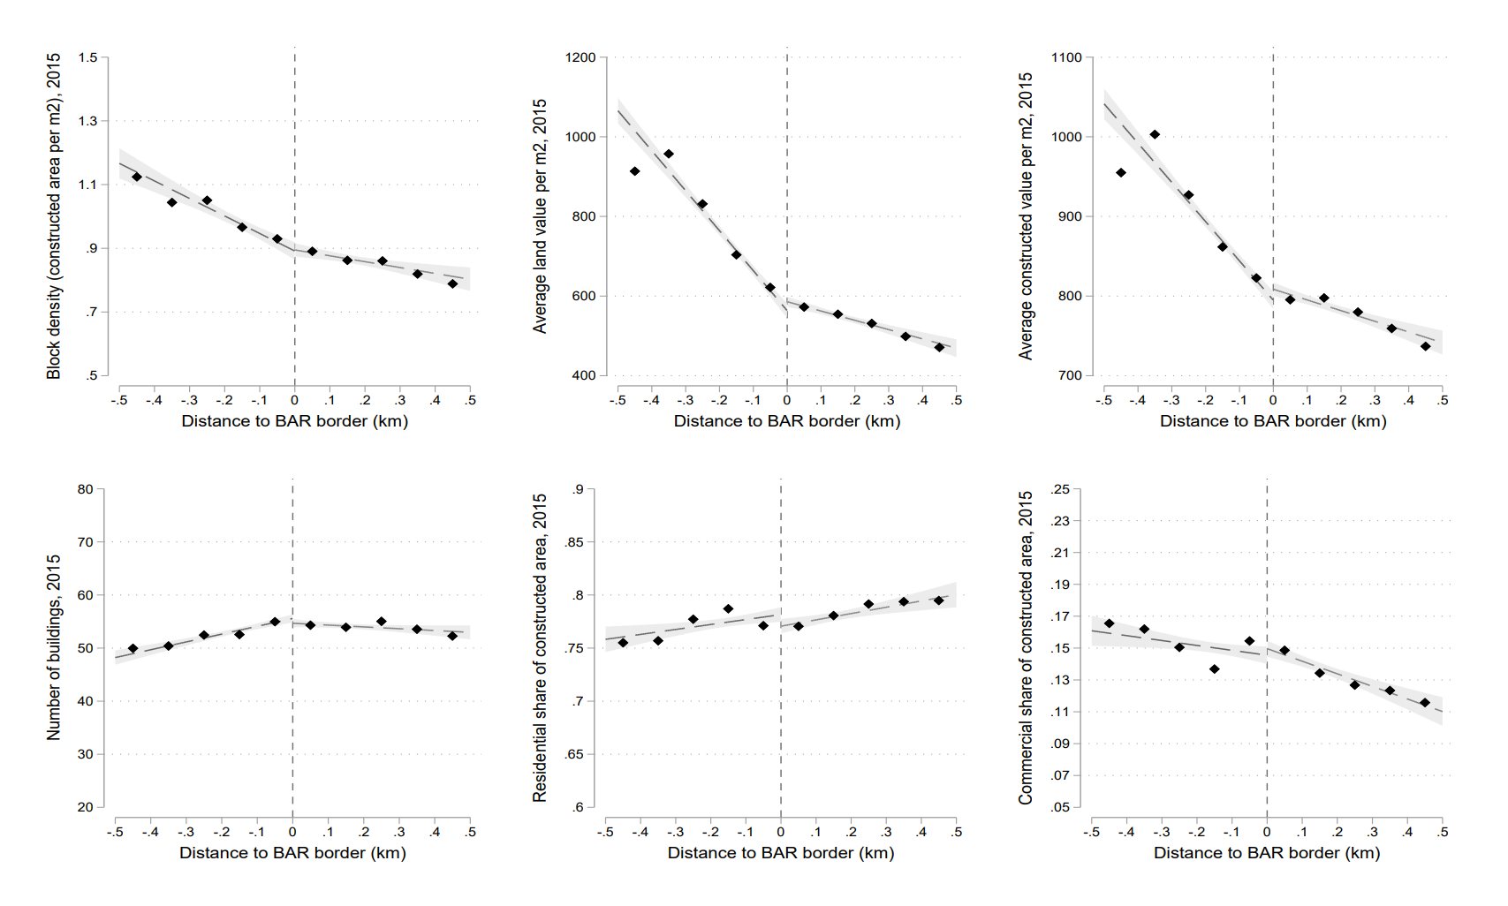
Pre-reform balance checks
Notes:
Data from IPTU property tax dataset. ~3 million properties per year.

Slide 25
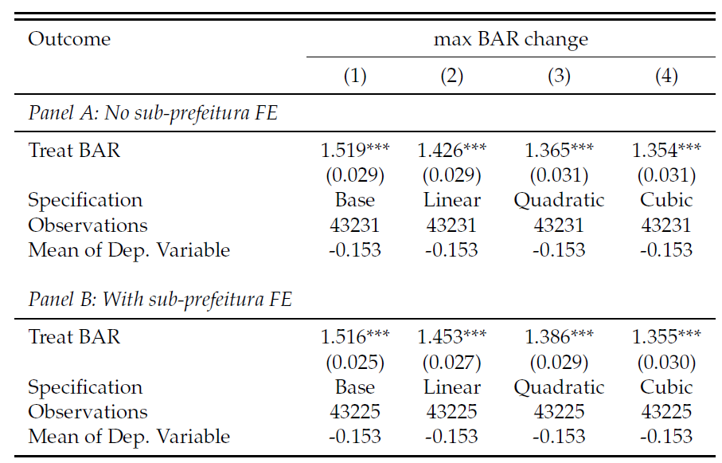
RD first stage

Slide 26
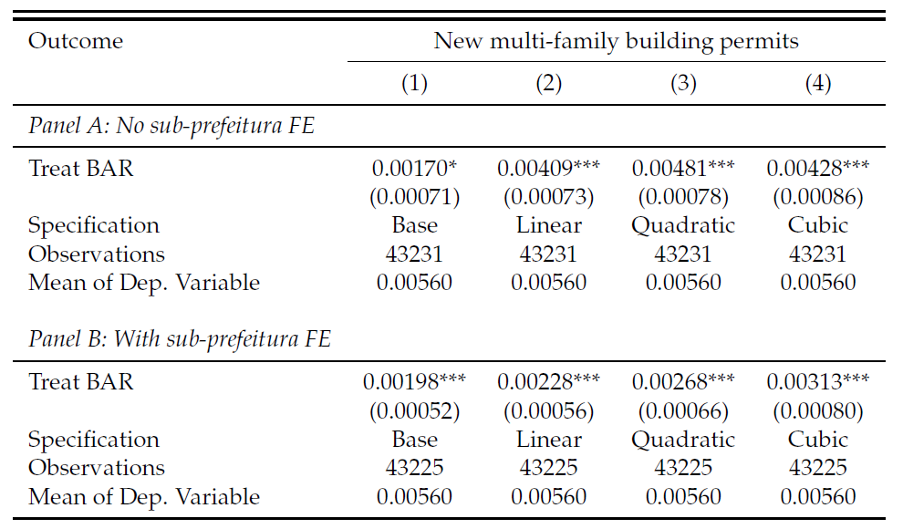
RD reduced form

Slide 27
RD bandwidth

Slide 28
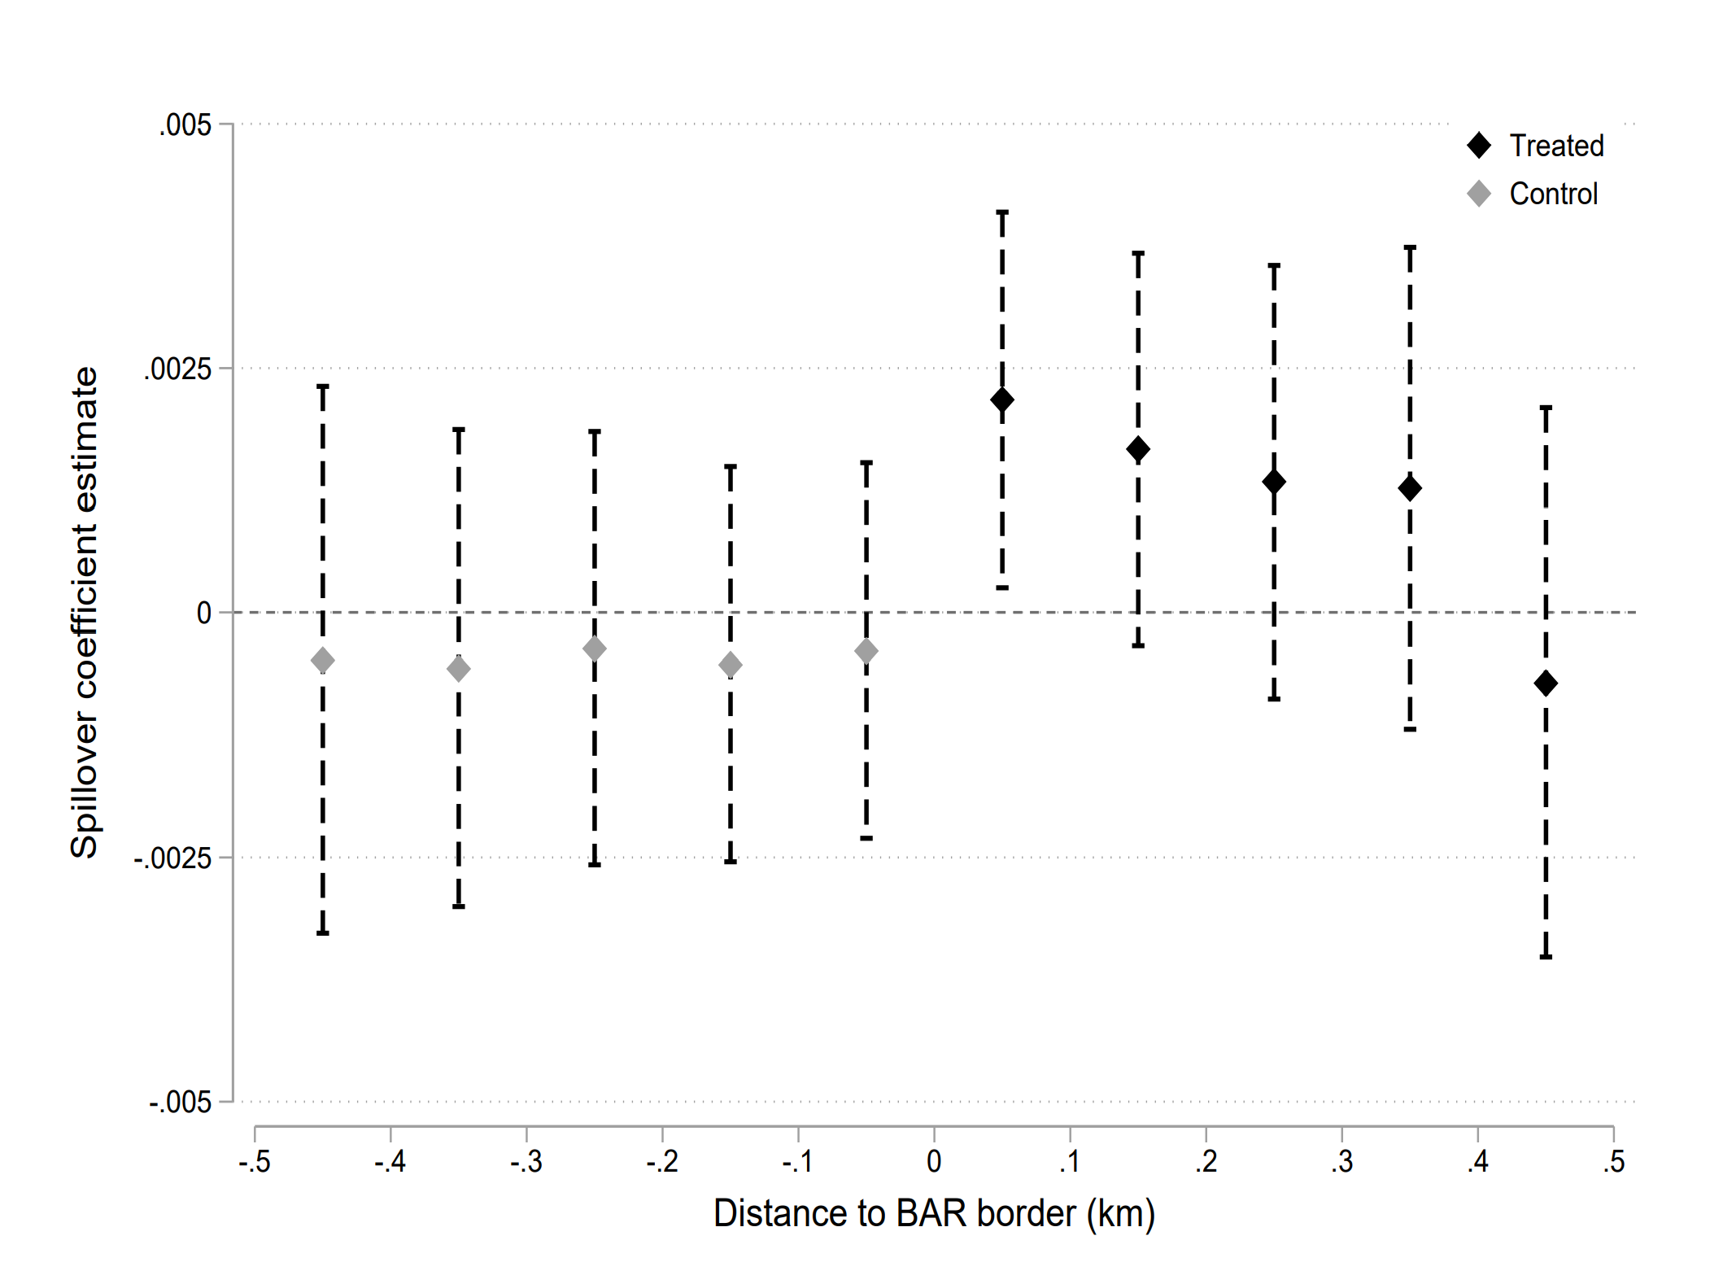
Spillover effects
Compare blocks near boundary to far away control blocks (Diamond and McQuade, 2019)
Found no spillovers from treatment to control blocks
Also no spillovers from treatment to treatment blocks
Notes:
Model will deal with economic spillovers on prices and quantities. This is just a test for short term permits.
Negative spillover on control blocks
Substitution of projects from nearby control to treatment blocks
Leads to over-estimate effect of BAR on construction
Positive spillover on control blocks
Nearby treatment blocks makes control blocks more attractive
Positive spillovers from treatment to treatment blocks
Part of treatment/control difference comes from agglomeration effect w/in treatment group
Permits are proxies for “anticipation of spillover effects”
Likely a diluted measure of agglomeration benefits

Slide 29
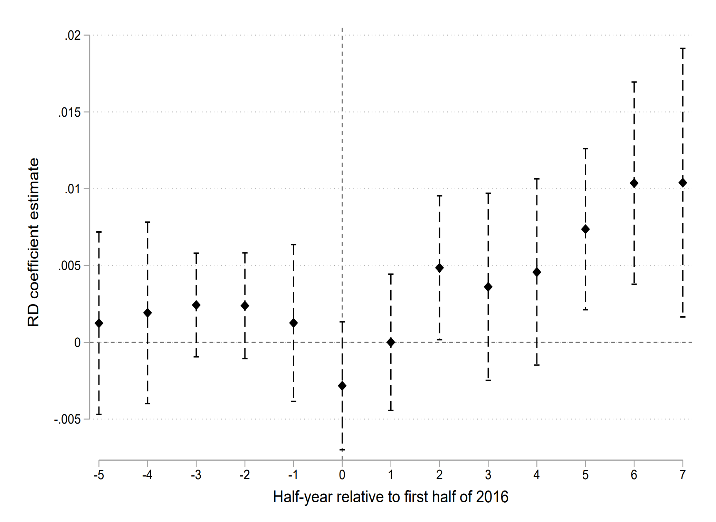
Dynamic RD effects

Slide 30
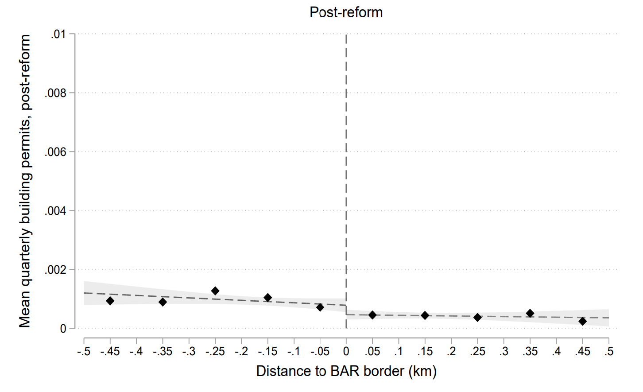
Reform impact on single-family permits

Slide 31
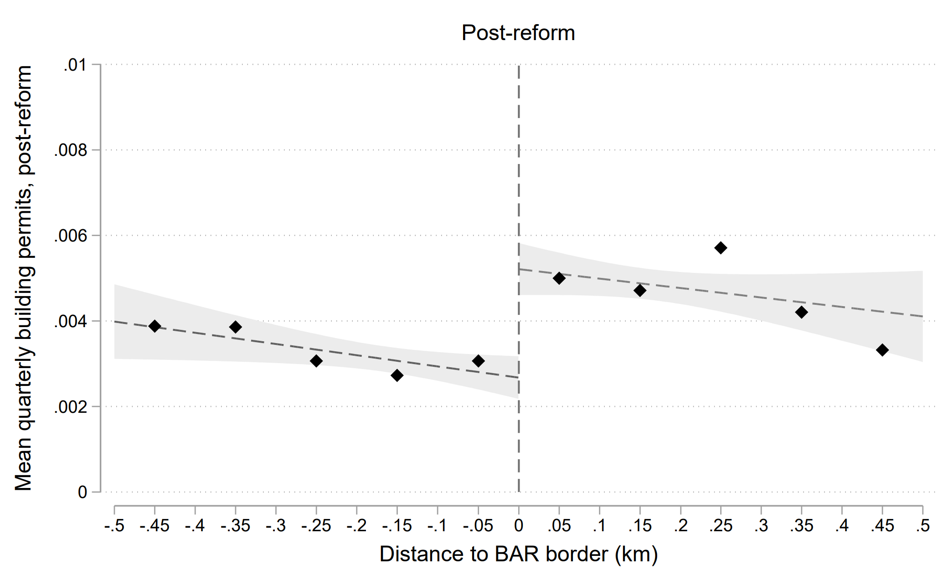
Effect of reform on approved permits

Slide 32
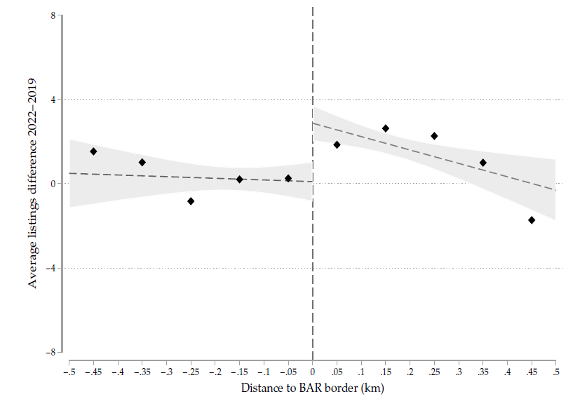
Effect of reform on housing availability – real estate listings
Real estate listings data from DataZap (Brazilian Zillow equivalent)
Blocks with increased Max BAR had 2.1 extra listings in 2022, ~10.3% increase relative to average listings in baseline year 2019

Slide 33
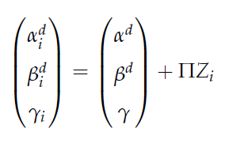
Demand model
Household i chooses between J neighborhoods, receiving utility:
where $p_{j}$ = housing price, $X_{j}^{d}$ = neighborhood amenities and demographics, $τ_{ij}$= individual commuting times, $ξ_{j}$ = unobserved location-specific component, and $ε_{ij}$ ~ i.i.d. T1EV
Preferences vary according to individual characteristics $Z_{i}$:
Two-stage micro BLP estimation, follows Bayer et al. (2007)
Sample: cross-section of 24800 MSA households in 2017 Data

Slide 34
Demand model - Data
2017 Survey data with 24,800 MSA households
Neighborhoods = 329 commuting zones
Characteristics: Average income, share college degree or more, share of paved road, and commuting patterns (given place of work)
House price per square meter based on listing data, 2015-16
Instrumented by features in outside zone ring – impact price through competition but no direct effect on utility (Bayer et al. 2007)
Stock of built environment from property tax data in 2017
Age, avg number of units per building, neighborhood density
Access to jobs from 2016 RAIS
RCMA: Neighboring wages weighted by commuting time (Tsivanidis, 2019)
Notes:
Survey: Pesquisa de Origem e Destino 2017.
Price data: from Properati website (eventually sold and renamed to Casafy).
IVs: Pavement, age of buildings, slope, share favelas, business activity
RCMA: Residential commuter market access measures the extent to which neighborhood is located near high-paying jobs, using travel times from a zone commuting matrix. Similar to what Tsivanidis (2018) used in his work.
Travel time: estimated from the survey data as a nonlinear function of distance btwn home and work commuting zones + population in home zone to capture congestion effects.

Slide 35
Supply model
Aggregate block data by neighborhood-distance to boundary bin
Limit number of geographies with no price data and still preserve RD
Permits $s_{j}$ are a function of prices $p_{j}$, neighborhood and zoning features $X_{j}^{s}$, and Max BAR $M_{j}$:
Supply modeled as Poisson regression
Discrete count, avoids predicting negative permits
Estimated with GMM-IV, where $M_{j}$and $p_{j}$ are endogenous
Max BAR IV: RD approach.
Price IV: localized Bartik labor demand shocks (Baum-Snow and Han, 2021)
Notes:
Prices are endogenous to S-D equilibrium and possibly measured with error, so we need an IV for price.
Price IV is a shift-share which interacts changes in aggregate labor demand with local labor market shares. Positive local labor demand shock → increase demand for local housing → increase price, but shouldn’t impact developer costs or zoning constraints. Shift demand curve without moving supply.
X includes construction density in j, the average building age, the average
number of units per building, and the average value of the pre-2016 zoning parameters and the 2016 non-BAR zoning parameters, across all blocks in j.
Estimation of exponential model with IVs done with GMM.

Slide 36
Bartik supply price IV: First stage

Slide 37
Bartik supply price IV: Reduced form

Slide 38
Model validation: prices

Slide 39
Model validation: demographics

Slide 40
Model map

